Slide 1
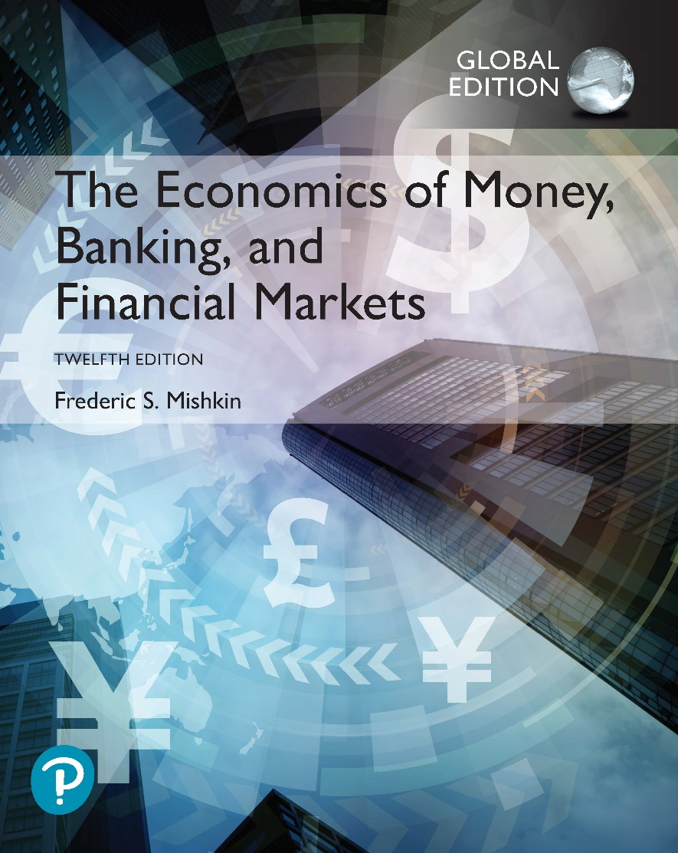
The Economics of Money, Banking, and Financial Markets
Twelfth Edition, Global Edition
Chapter 20
Quantity Theory, Inflation and the Demand for Money
Copyright © 2019 Pearson Education, Ltd.
Notes:
If this PowerPoint presentation contains mathematical equations, you may need to check that your computer has the following installed:
1) MathType Plugin
2) Math Player (free versions available)
3) NVDA Reader (free versions available)

Slide 2
Preview
This chapter examines the quantity theory of money and its link to the demand for money.
The link between interest rates and the demand for money is then addressed.

Slide 3
Learning Objectives
Assess the relationship between money growth and inflation in the short run and the long run, as implied by the quantity theory of money.
Identify the circumstances under which budget deficits can lead to inflationary monetary policy.
Summarize the three motives underlying the liquidity preference theory of money demand.
Identify the factors underlying the portfolio choice theory of money demand.
Assess and interpret the empirical evidence on the validity of the liquidity preference and portfolio theories of money demand.

Slide 4
Quantity Theory of Money (1 of 4)
Velocity of Money and The Equation of Exchange:

Slide 5
Quantity Theory of Money (2 of 4)
Velocity fairly constant in the short run
Aggregate output at full-employment level
Changes in money supply affect only the price level
Movement in the price level results solely from change in the quantity of money

Slide 6
Quantity Theory of Money (3 of 4)
Demand for money: To interpret Fisher’s quantity theory in terms of the demand for money…
Divide both sides by V
When the money market is in equilibrium
M = M^{d}
Let
M^{d} = k × PY
Because k is constant, the level of transactions generated by a fixed level of PY determines the quantity of M^{d}.
The demand for money is not affected by interest rates.

Slide 7
Quantity Theory of Money (4 of 4)
From the equation of exchange to the quantity theory of money:
Fisher’s view that velocity is fairly constant in the short run, so that transforms the equation of exchange into the quantity theory of money, which states that nominal income (spending) is determined solely by movements in the quantity of money M.

Slide 8
Quantity Theory and the Price Level
Because the classical economists (including Fisher) thought that wages and prices were completely flexible, they believed that the level of aggregate output Y produced in the economy during normal times would remain at the full-employment level.
Dividing both sides by Y̅, we can then write the price level as follows:

Slide 9
Quantity Theory and Inflation
Percentage Change in (x × y) = (Percentage Change in x) + (Percentage Change in y)
Using this mathematical fact, we can rewrite the equation of exchange as follows:
Subtracting from both sides of the preceding equation and recognizing that the inflation rate is the growth rate of the price level,
Since we assume velocity is constant, its growth rate is zero, so the quantity theory of money is also a theory of inflation:

Slide 10
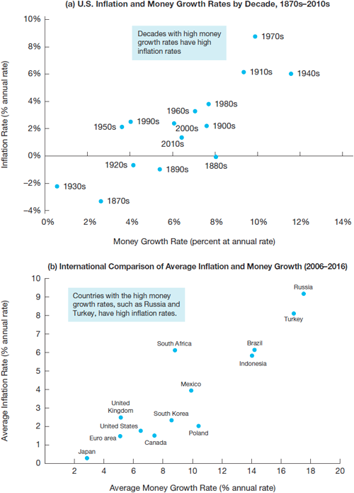
Testing the Quantity Theory: Relationship Between Inflation and Money Growth
Sources: Panel (a): Milton Friedman and Anna Schwartz, Monetary Trends in the United States and the United Kingdom:
Their Relation to Income, Prices, and Interest Rates, 1867–1975; Federal Reserve Bank of St. Louis, FRED database: http://research.stlouisfed.org/fred2/. Panel (b): International Financial Statistics. International Monetary Fund, http://www.imfstatistics.org/imf/.

Slide 11
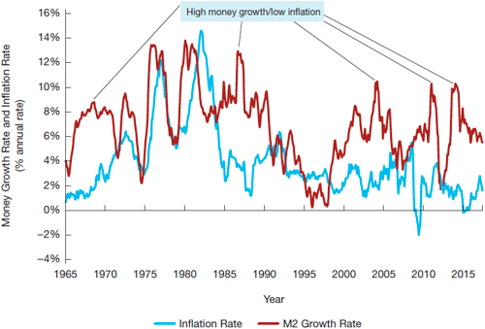
Figure 2 Annual U.S. Inflation and Money Growth Rates, 1965–2015
Source: Federal Reserve Bank of St. Louis, FRED database: http://research.stlouisfed.org/fred2/series/CPIAUCSL; http://research.stlouisfed.org/fred2/series/M2SL.

Slide 12
Budget Deficits and Inflation (1 of 2)
There are two ways the government can pay for spending: raise revenue or borrow
Raise revenue by levying taxes or go into debt by issuing government bonds
The government can also create money and use it to pay for the goods and services it buys

Slide 13
Budget Deficits and Inflation (2 of 2)
The government budget constraint thus reveals two important facts:
If the government deficit is financed by an increase in bond holdings by the public, there is no effect on the monetary base and hence on the money supply.
But, if the deficit is not financed by increased bond holdings by the public, the monetary base and the money supply increase (the method is called monetizing the debt)
DEF = G – T = ∆MB + ∆B

Slide 14
Hyperinflation
Hyperinflations are periods of extremely high inflation of more than 50% per month.
Many economies—both poor and developed—have experienced hyperinflation over the last century, but the United States has been spared such turmoil.
One of the most extreme examples of hyperinflation throughout world history occurred recently in Zimbabwe in the 2000s.

Slide 15
Keynesian Theories of Money Demand
Keynes’s liquidity preference theory
Why do individuals hold money? Three motives:
Transactions motive
Precautionary motive
Speculative motive
Distinguishes between real and nominal quantities of money

Slide 16
Transactions Motive
Keynes initially accepted the quantity theory view that the transactions component is proportional to income.
Later, he and other economists recognized that new methods for payment, referred to as payment technology, could also affect the demand for money.

Slide 17
Precautionary Motive
Keynes also recognized that people hold money as a cushion against unexpected wants.
Keynes argued that the precautionary money balances people want to hold would also be proportional to income.

Slide 18
Speculative Motive
Keynes also believed people choose to hold money as a store of wealth, which he called the speculative motive.

Slide 19
Putting the Three Motives Together (1 of 2)

Slide 20
Putting the Three Motives Together (2 of 2)
Velocity is not constant:
The procyclical movement of interest rates should induce procyclical movements in velocity.
Velocity will change as expectations about future normal levels of interest rates change

Slide 21
Portfolio Theories of Money Demand
Theory of portfolio choice and Keynesian liquidity preference
The theory of portfolio choice can justify the conclusion from the Keynesian liquidity preference function that the demand for real money balances is positively related to income and negatively related to the nominal interest rate.
Other factors that affect the demand for money:
Wealth
Risk
Liquidity of other assets

Slide 22
Summary Table 1 Factors That Determine the Demand for Money
Factors That Determine the Demand for Money | Blank | Blank | Blank
Variable | Change in Variable | Money Demand Response | Reason
Interest rates | ↑ | ↓ | Opportunity cost of money rises
Income | ↑ | ↑ | Higher value of transactions
Payment technology | ↑ | ↓ | Less need for money in transactions
Wealth | ↑ | ↑ | More resources to put into money
Riskiness of other assets | ↑ | ↑ | Money relatively less risky and so more desirable
Inflation risk | ↑ | ↓ | Money relatively more risky and so less desirable
Liquidity of other assets | ↑ | ↓ | Money relatively less liquid and so less desirable
Note: Only increases (↑) in the factors are shown; the effects of decreases in the variables on the exchange rate are the opposite of those indicated in the “Response” column.

Slide 23
Empirical Evidence on the Demand for Money
Precautionary demand:
Similar to transactions demand
As interest rates rise, the opportunity cost of holding precautionary balances rises
The precautionary demand for money is negatively related to interest rates

Slide 24
Interest Rates and Money Demand
We have established that if interest rates do not affect the demand for money, velocity is more likely to be constant—or at least predictable—so that the quantity theory view that aggregate spending is determined by the quantity of money is more likely to be true.
However, the more sensitive the demand for money is to interest rates, the more unpredictable velocity will be, and the less clear the link between the money supply and aggregate spending will be.

Slide 25
Stability of Money Demand
If the money demand function is unstable and undergoes substantial, unpredictable shifts as Keynes believed, then velocity is unpredictable, and the quantity of money may not be tightly linked to aggregate spending, as it is in the quantity theory.
The stability of the money demand function is also crucial to whether the Federal Reserve should target interest rates or the money supply.
If the money demand function is unstable and so the money supply is not closely linked to aggregate spending, then the level of interest rates the Fed sets will provide more information about the stance of monetary policy than will the money supply.

